Slide 1

Serverless Image Processing on AWS
DV1566 HT25 lp2 Introduction to Cloud Computing - Final Project
Team 14 Yalamati Nikhil Souri, Ajay Kumar Reddy Bindela, Shaik Mahammed Sameen
Supervisors: Emiliano Casalicchio and Shahrooz Abghari | December 17, 2024

Slide 2
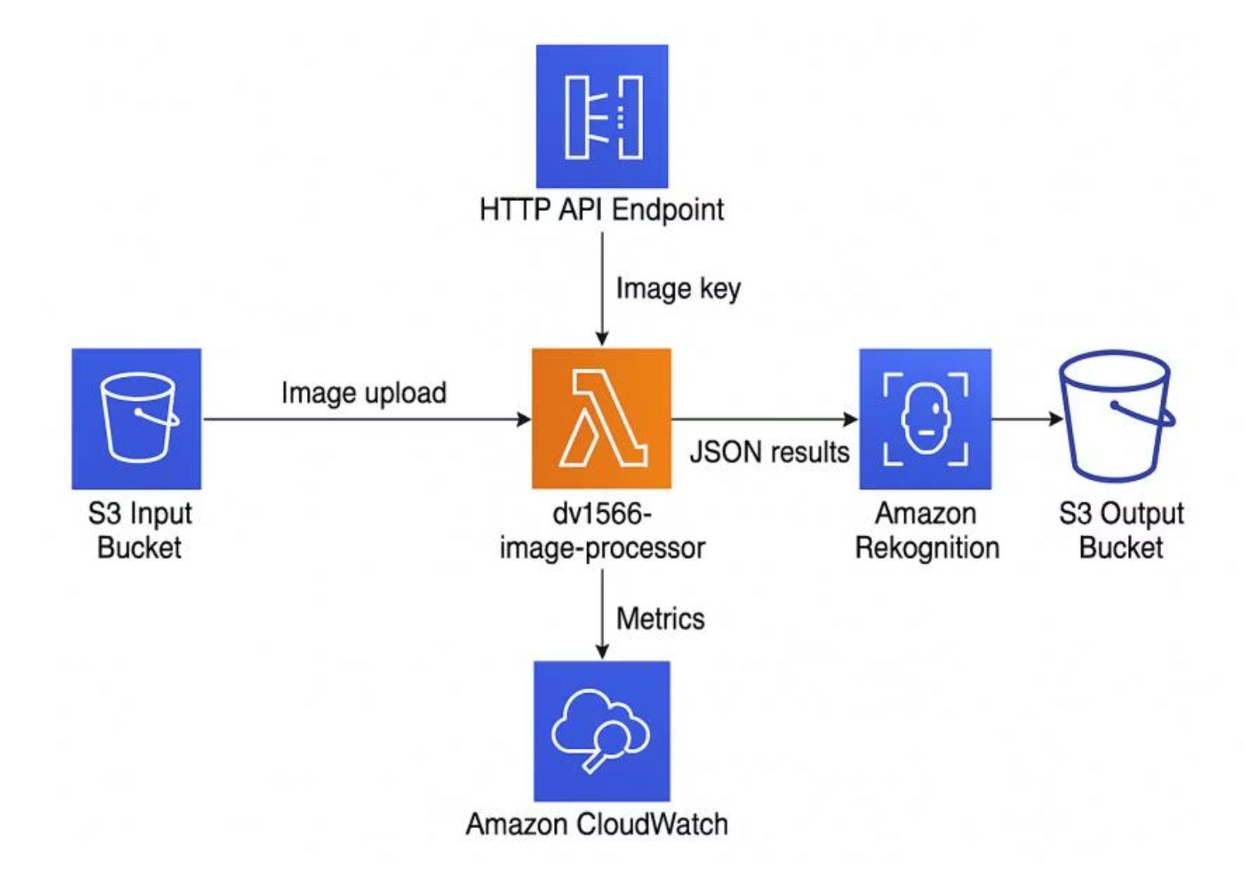
Project Overview & Objectives
Core Challenge
Demonstrate a scalable, serverless image-processing platform using AWS services that can handle multiple transformation operations and provide real-time performance metrics.
Key Capabilities
Label detection using Amazon Rekognition
Pixel-level transformations (grayscale, resize, thumbnail)
Browser-based UI for direct uploads
Custom CloudWatch metrics with operation dimensions

Slide 3





AWS Architecture Components
Amazon S3
AWS Lambda
API Gateway
Two buckets: input bucket (dv1566-image-input-nikhil) for originals and output bucket (dv1566-image-output-nikhil) with operation-specific prefixes
Core function dv1566-image-processor handles transformations using Pillow library and Rekognition integration
HTTP API endpoint (POST /process) enables external client triggers and browser-based uploads
Amazon Rekognition
CloudWatch
Performs image analysis providing labels with confidence scores for object and scene detection
Stores custom metrics and Lambda metrics with operation-aware dimensions for performance analysis

Slide 4
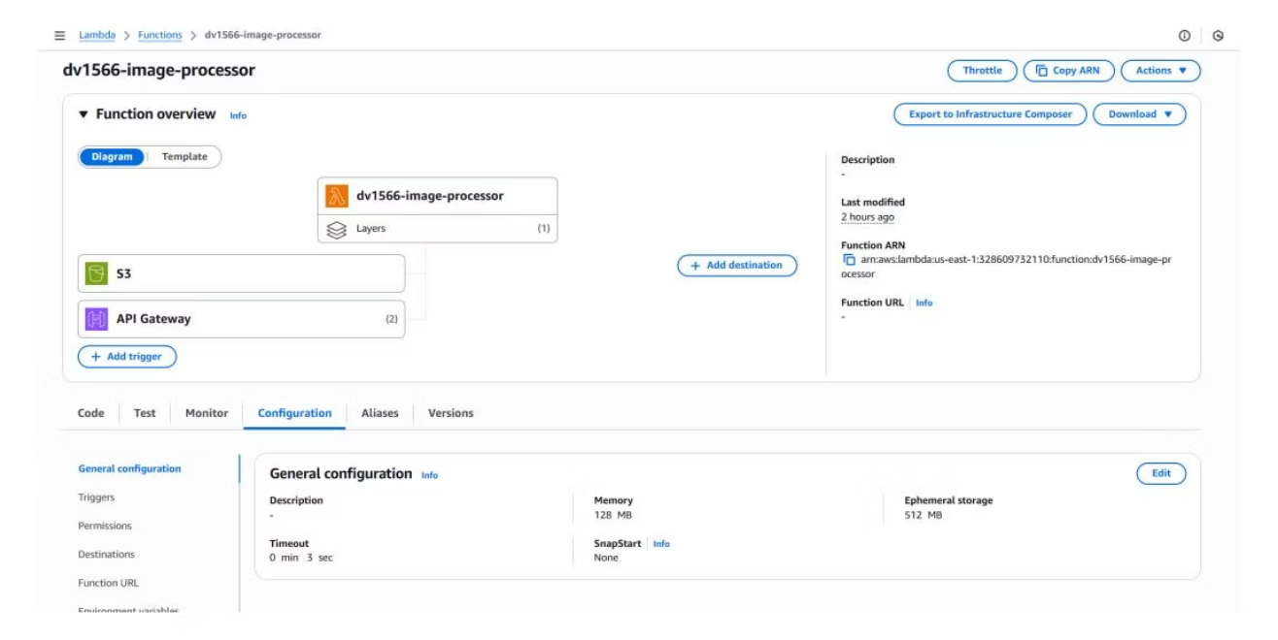
Lambda Function Implementation
Processing Pipeline
01
Download Image
Retrieve original from S3 input bucket
02
Apply Transformation
Use Pillow for grayscale, resize, or thumbnail
03
Store Result
Save to output bucket under operation prefix
04
Run Rekognition
Optionally detect labels and confidence scores
05
Publish Metrics
Send custom metrics to CloudWatch
06
Environment Variables: INPUT_BUCKET and OUTPUT_BUCKET configured for bucket names. IAM role LabRole provides necessary permissions.
Return Response
JSON with metadata, labels, and base64 image

Slide 5
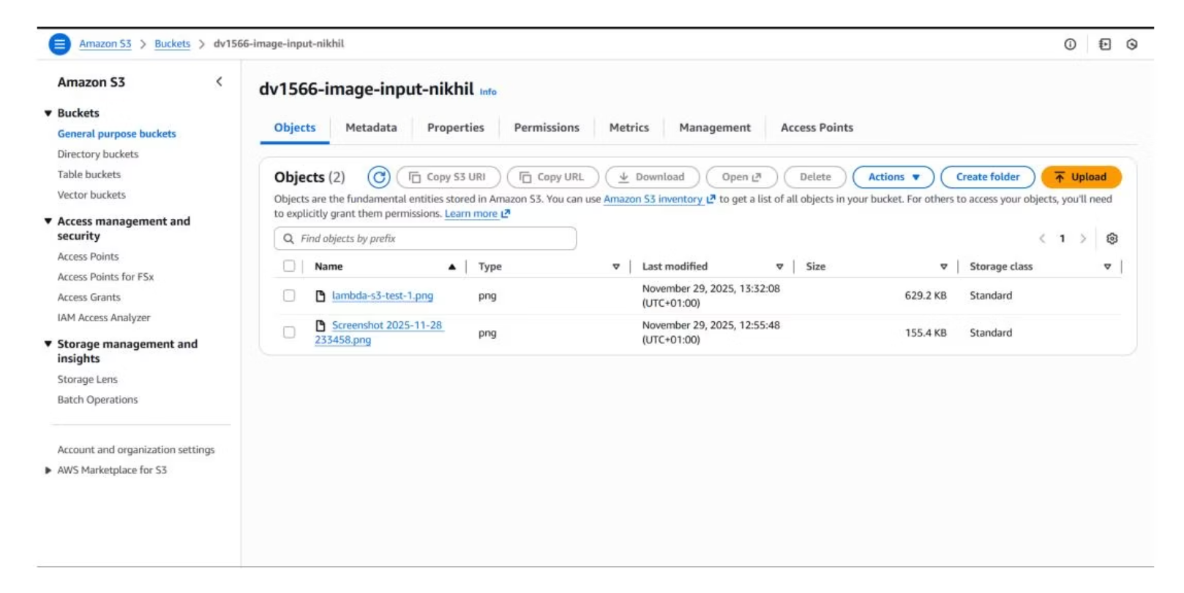
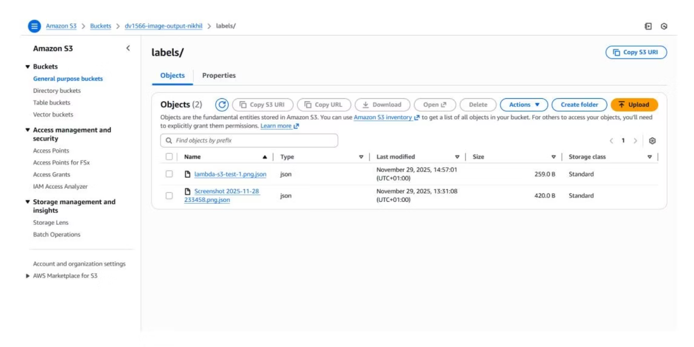
S3 Bucket Organization
Input Bucket Structure
Output Bucket Structure
Original images stored in dv1566-image-input-nikhil, including uploads/ prefix for browser-based submissions
Processed images organized by operation: processed/original/, processed/grayscale/, processed/resize/, processed/thumbnail/

Slide 6

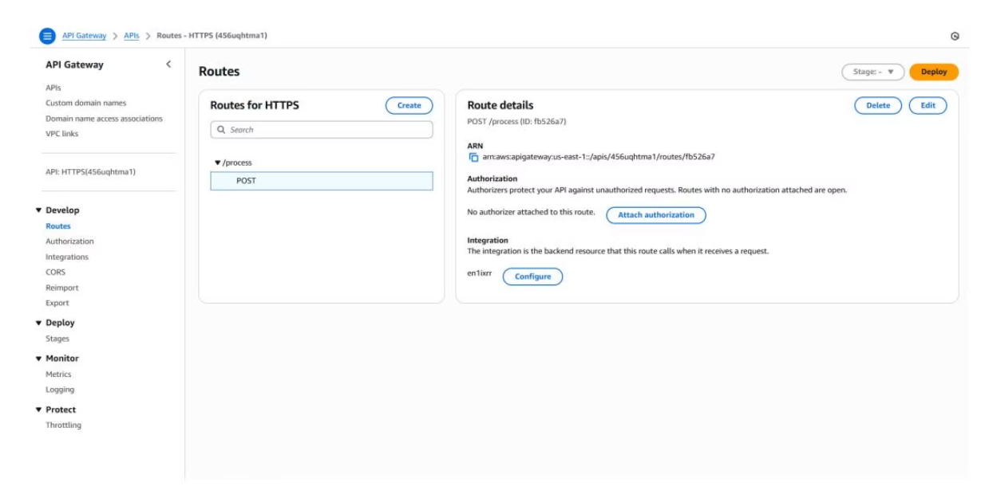
API Gateway Integration
HTTP Endpoint Configuration
Single route POST /process accepts JSON requests in two modes:
S3 Mode (Legacy)
{"bucket": "dv1566-image-input-nikhil",
"key": "image.png",
"operation": "labels",
"runRekognition": true}
Browser Mode
{"imageBase64": "base64string...",
"operation": "grayscale",
"width": 800,
"height": 600,
"runRekognition": true}
Endpoint URL: https://456uqhtma1.execute-api.us-east-1.amazonaws.com/process

Slide 7

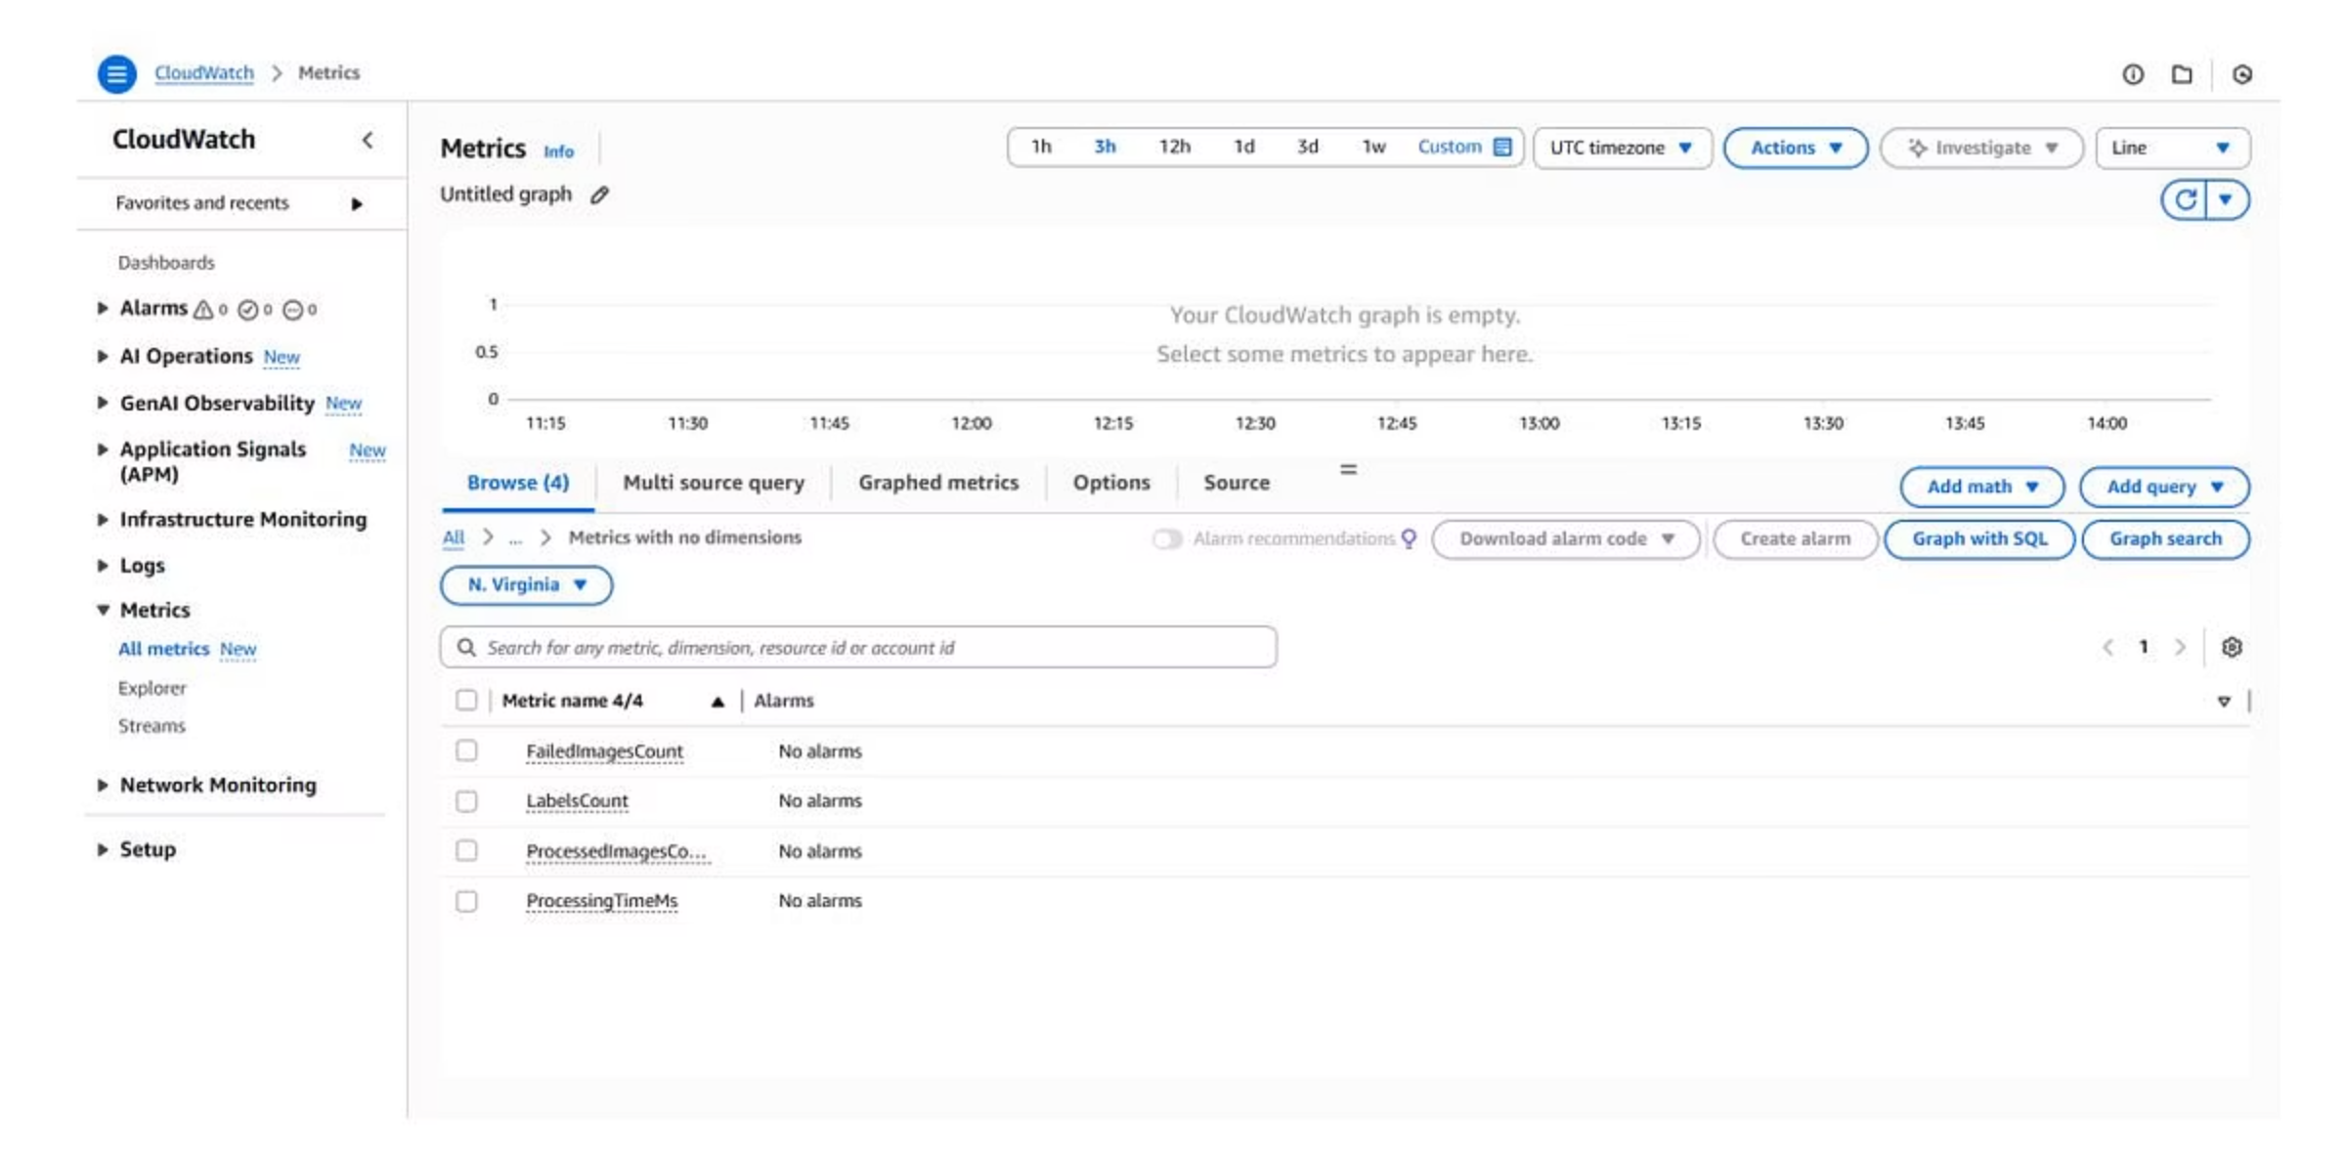
CloudWatch Metrics & Monitoring
4
5
100+
Custom Metrics
Operation Types
Milliseconds
ProcessedImagesCount, ProcessingTimeMs, LabelsCount, FailedImagesCount
Labels, grayscale, resize, thumbnail, error dimensions
Typical processing time per image including transformations
Dashboard dv1566-image-dashboard visualizes both custom application metrics and AWS Lambda metrics (invocations, duration, errors, concurrent executions) with operation-specific filtering.

Slide 8
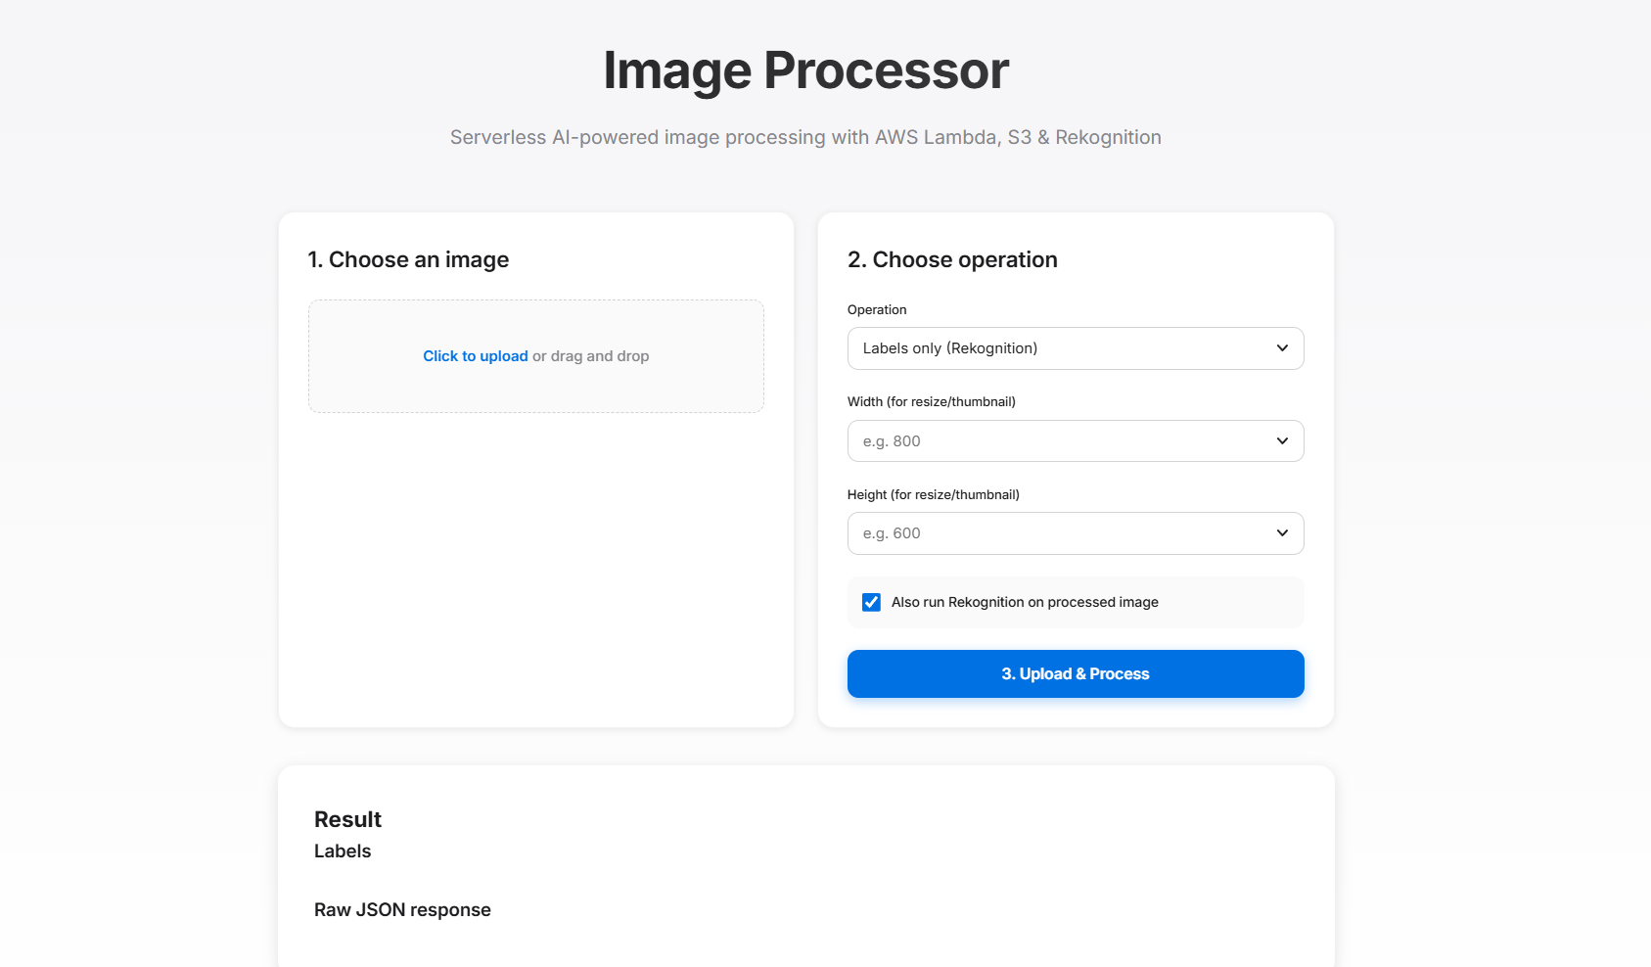
Browser-Based User Interface
UI Capabilities
Local file selection and upload
Base64 encoding for direct API submission
Operation selection (labels, grayscale, resize, thumbnail)
Custom width/height parameters for resizing
Rekognition enable/disable toggle
Real-time display of processed images
Label visualization with confidence scores
Raw JSON response for debugging
Single HTML file with JavaScript for seamless client-side processing and immediate visual feedback

Slide 9
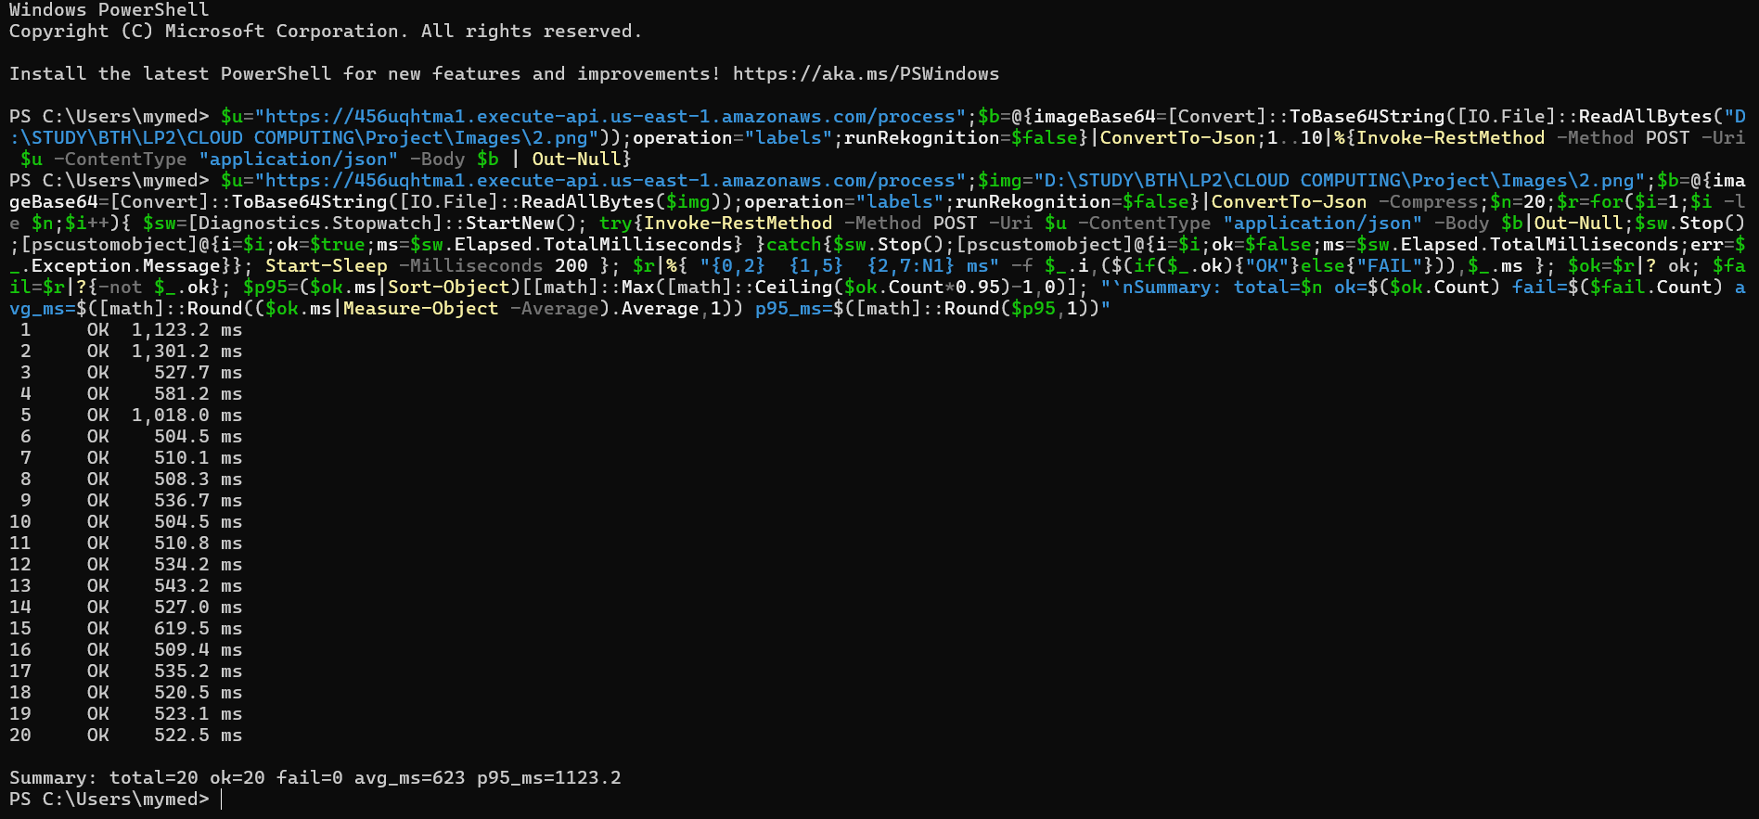




Scalability Testing & Results
Load Test Methodology
Baseline
Single HTTP request to verify metrics appear
API Load
10 consecutive HTTP requests via PowerShell loop
S3 Burst
5-10 simultaneous uploads to trigger event burst
Analysis
Observe spikes in CloudWatch dashboard metrics
Clear increases in ProcessedImagesCount, Lambda invocations, and ProcessingTimeMs demonstrate automatic scaling without manual intervention. Average processing time remained stable across load periods.

Slide 10

Conclusions & Future Directions
Key Achievements
Limitations & Future Work
Successfully implemented end-to-end serverless image processing pipeline
Small-scale testing due to AWS Academy Learner Lab constraints
Integrated multiple AWS services (S3, Lambda, API Gateway, Rekognition, CloudWatch)
Limited concurrency testing in production scenarios
Enhancement Opportunities
Extended beyond basic label detection to include pixel-level transformations
Additional processing features (filters, effects, format conversion)
Developed intuitive browser-based UI for direct user interaction
Advanced performance analysis with larger datasets
Demonstrated automatic scalability with operation-aware metrics
Richer frontend with batch processing capabilities
Processing time: hundreds of milliseconds per image
Production deployment with enhanced monitoring and alarms
Cost optimization analysis across operation types

